Slide 1

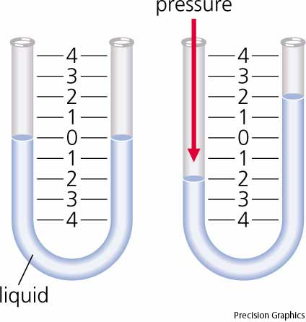
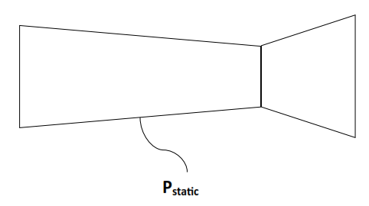
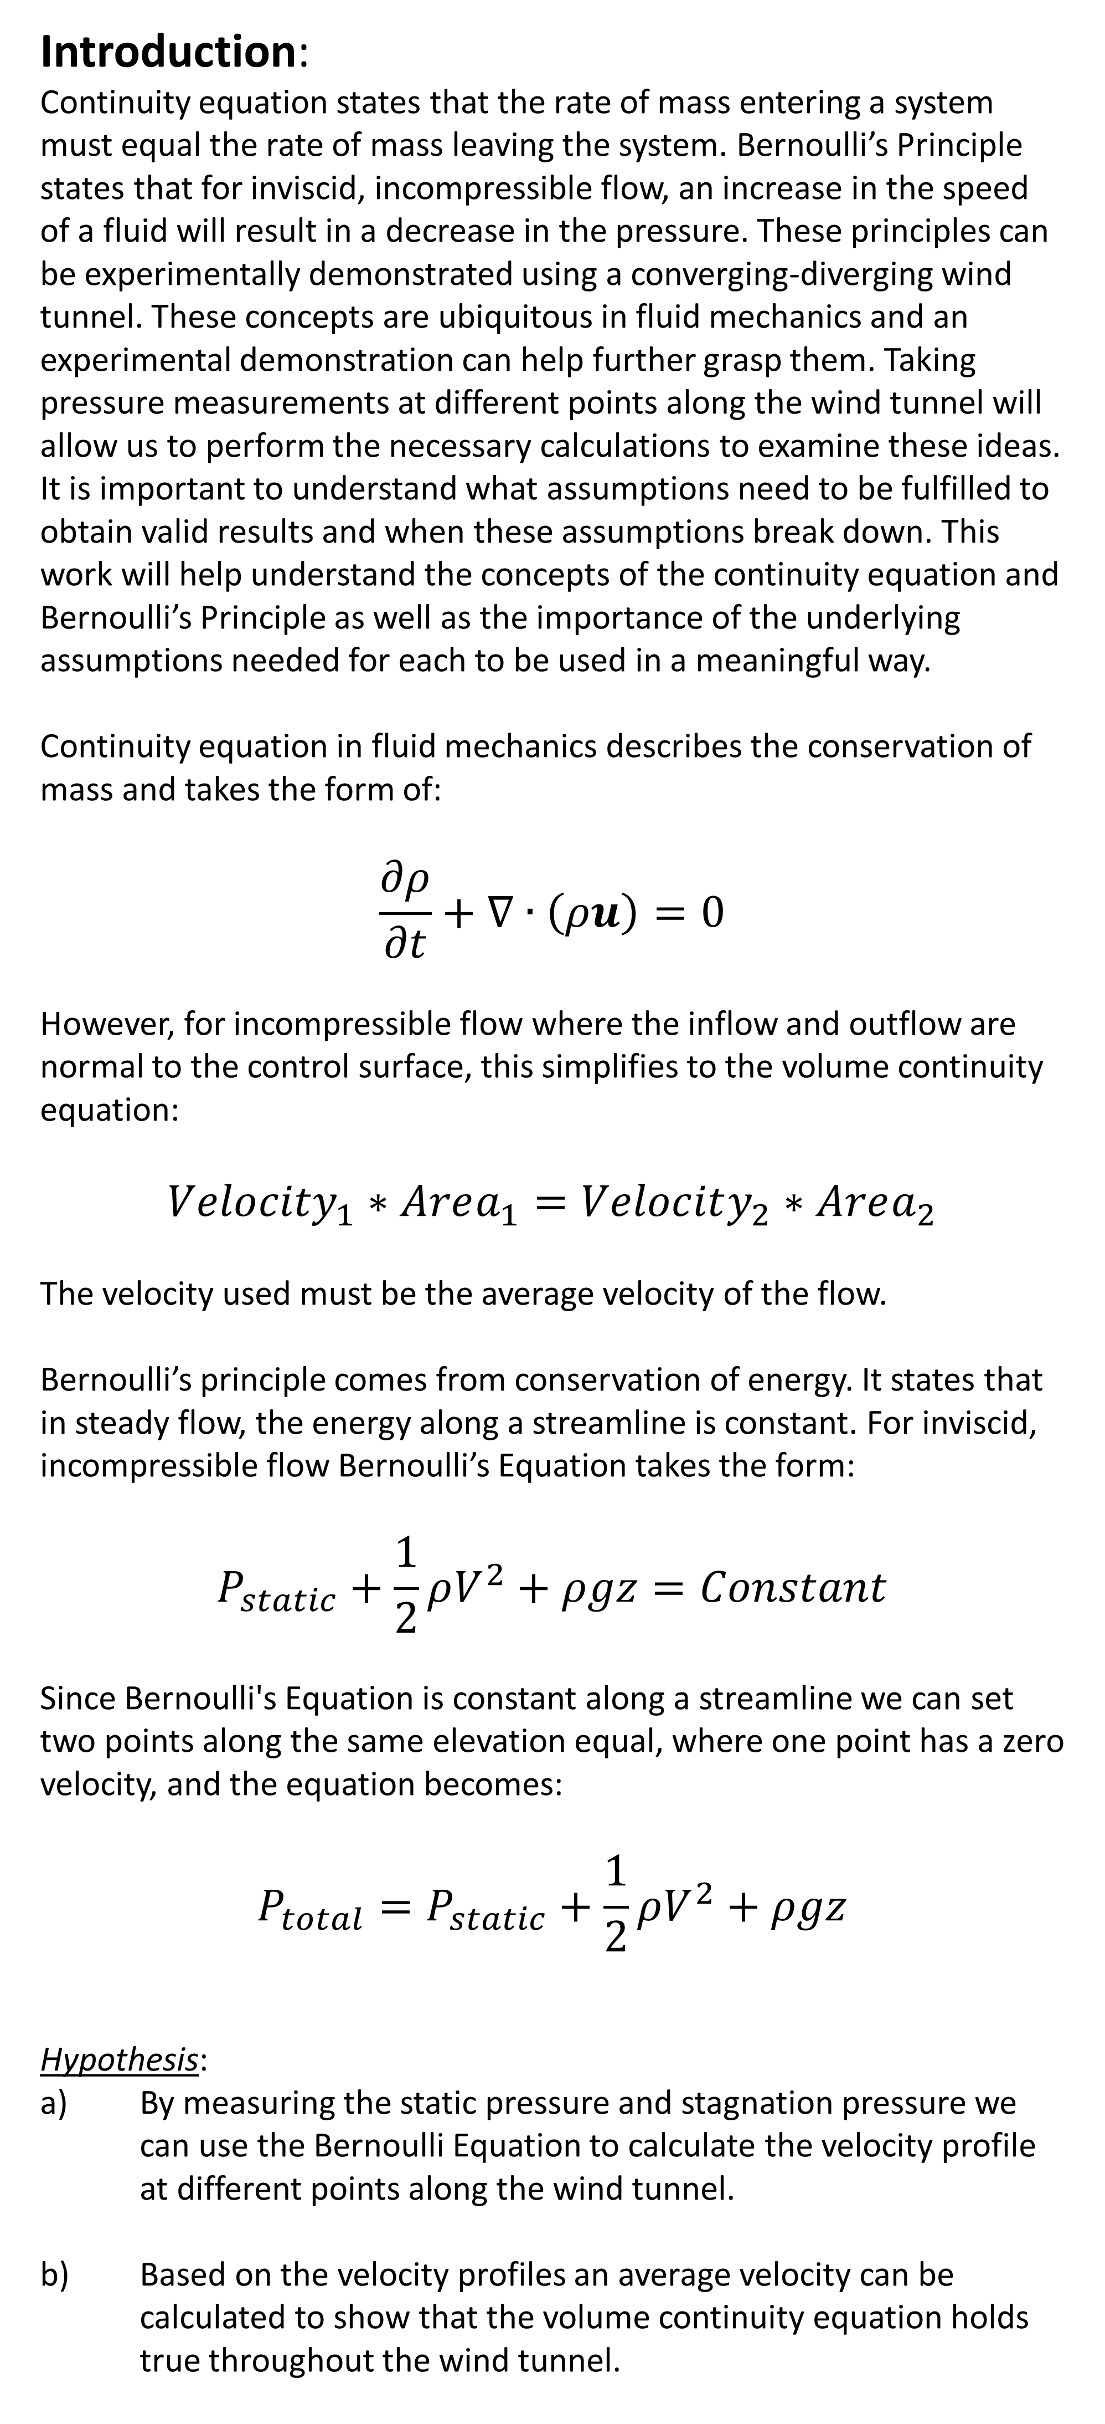
Continuity Equation and Bernoulli’s Principle
in a Converging-Diverging Wind Tunnel
Boston University: Department of Mechanical Engineering
Steven Scherr
Introduction:
Continuity equation states that the rate of mass entering a system must equal the rate of mass leaving the system. Bernoulli’s Principle states that for inviscid, incompressible flow, an increase in the speed of a fluid will result in a decrease in the pressure. These principles can be experimentally demonstrated using a converging-diverging wind tunnel. These concepts are ubiquitous in fluid mechanics and an experimental demonstration can help further grasp them. Taking pressure measurements at different points along the wind tunnel will allow us to perform the necessary calculations to examine these ideas. It is important to understand what assumptions need to be fulfilled to obtain valid results and when these assumptions break down. This work will help understand the concepts of the continuity equation and Bernoulli’s Principle as well as the importance of the underlying assumptions needed for each to be used in a meaningful way.
Continuity equation in fluid mechanics describes the conservation of mass and takes the form of:
$$\frac{∂ρ}{∂t}+∇∙\left(ρu\right)=0$$
However, for incompressible flow where the inflow and outflow are normal to the control surface, this simplifies to the volume continuity equation:
$${Velocity}_{1}∗Area_{1}=Velocity_{2}∗Area_{2}$$
The velocity used must be the average velocity of the flow.
Bernoulli’s principle comes from conservation of energy. It states that in steady flow, the energy along a streamline is constant. For inviscid, incompressible flow Bernoulli’s Equation takes the form:
$$P_{static}+\frac{1}{2}ρV^{2}+ρgz=Constant$$
Since Bernoulli's Equation is constant along a streamline we can set two points along the same elevation equal, where one point has a zero velocity, and the equation becomes:
$$P_{total}=P_{static}+\frac{1}{2}ρV^{2}+ρgz$$
Hypothesis:
By measuring the static pressure and stagnation pressure we can use the Bernoulli Equation to calculate the velocity profile at different points along the wind tunnel.
Based on the velocity profiles an average velocity can be calculated to show that the volume continuity equation holds true throughout the wind tunnel.
Methods:
In order to take accurate pressure measurements we must first calibrate the pressure transducer using a microtector manometer. To do this we take transducer and manometer height measurements with the fan off and then on.
Using the experimentally found velocity profiles, an average velocity at each port was calculated using numerical integration in the form of the trapezoid rule. This average velocity was then used in the continuity equation to find the flow rate. The flow rates for ports 1, 5, 8, and 10 are plotted below in figure 4.
Figure 1
P_{kiel}
P_{static}
P_{kiel}
P_{static}
P_{kiel}
Figure 1 represents the wind tunnel, location of the static and stagnation pressure ports and calibration of the microtector
Figure 4
Figure 4 shows the experimentally derived flow rates using continuity equation at 4 ports along the wind tunnel
Figure 2
Using theoretical velocities calculated by assuming the volumetric flow rate measured at port 8 is valid for all ports, we can calculate theoretical static pressures at each port as well. These theoretical velocities and pressures are plotted against the experimental data below to look for deviation from the theory.
Figure 2 shows the linear calibration of the pressure transducer as well as the equation relating voltage to pressure
Following the initial calibration step, the pressure transducer was used to measure the differential pressure between the total pressure and static pressure at a number of vertical and horizontal positions within the wind tunnel.
Results/Discussion:
Figure 5
Figure 6
By adjusting the height of the kiel probe and utilizing the Bernoulli equation experimental velocities were calculated at ports 1,5,8 & 10 at varying heights through out the wind tunnel. By plotting height versus velocity we can see a visual representation of the actual velocity profile.
Figure 5 shows theoretical velocity plotted with a solid line and experimental velocity plotted as points along the wind tunnel. Figure 6 shows theoretical static pressure at each port plotted in a solid line as well as experimental static pressure plotted as points.
Figure 3
Conclusion:
Continuity equation and Bernoulli’s principle appear to accurately calculate velocity, pressure, and flow rate only in the converging section of the wind tunnel and not the diverging section. In order the apply the conservation of mass and energy through these equations certain assumptions are made which appear to be invalid in the diverging section of the wind tunnel. Since it can be safely assumed that the flow is inviscid and incompressible, it is likely that the streamlines are mixing and the flow is not travelling perpendicular to the control surface. By measuring static and stagnation pressure one can calculate the velocity and volumetric flow rate using Bernoulli’s equation and the continuity equation in the converging section of the wind tunnel only.
Acknowledgement:
Thank you to Dr. Tyrone Porter, Dr. Caleb Farney, David Campbell and Mark Mennesses for developing and maintaining this lab and the facilities.
Figure 3 shows the velocity profile calculated using the Bernoulli equation at 4 horizontal positions along the wind tunnel

